Slide 1

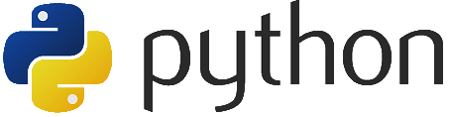
Introduction to

Slide 2
Contents at a Glance
What is Python?
History and Timeline
Python 2 and 3
Philosophy
Key Features
Paradigms
Popularity
Getting Started
IDLE IDE
First Program
Other IDEs
Python Basics
Variables and Data Types
Operators
Type Conversion
Syntax and Structures
Input / Output
Identifiers
lines
Block and Indentation
Quotations
Comments

Slide 3
Contents at a Glance
Control Flow
Composite Types
Lists
Tuples
Ranges
Dictionaries
Functions
Definitions and Calling
Nested Functions
First-Class Objects
Object-Oriented Python
Classes
Inheritance
Garbage Collection
Be Pythonic!
Summary
References

Slide 4
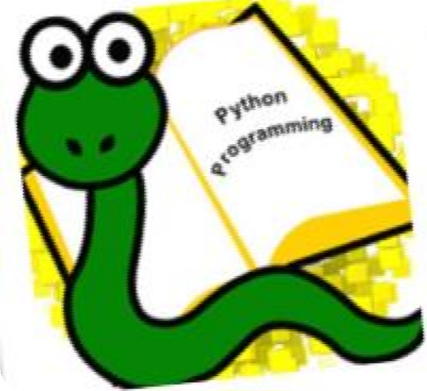

What is Python?
Python is a widely-used general purpose (both industry and academia) high-level Programming language.
It combines the power of systems languages, such as C and Java, with the ease and rapid development of scripting languages, such as Ruby.

Slide 5
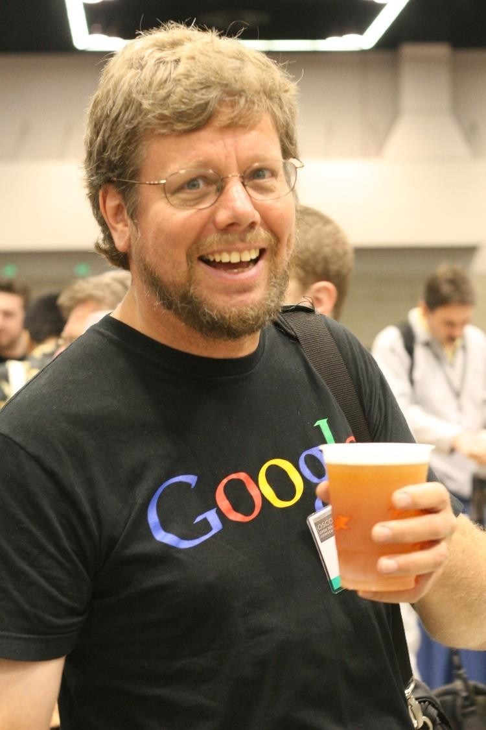
History and Timeline
Python Invented by Guido van Rossum in1991 at CWI in the Netherlands.
Python reached version 1.0 in January 1994. The major new features included in this release were the functional programming tools.
Van Rossum
Born: 31 January 1956 (age 58)

Slide 6
History and Timeline
Python 1.0 - January 1994
Python 1.5 - December 31, 1997
Python 1.6 - September 5, 2000
Python 2.0 - October 16, 2000
Python 2.1 - April 17, 2001
Python 2.2 - December 21, 2001
Python 2.3 - July 29, 2003
Python 2.4 - November 30, 2004
Python 2.5 - September 19, 2006
Python 2.6 - October 1, 2008
Python 2.7 - July 3, 2010
Python 3.0 - December 3, 2008
Python 3.1 - June 27, 2009
Python 3.2 - February 20, 2011
Python 3.3 - September 29, 2012
Python 3.4 - March 16, 2014

Slide 7
Python 2 and 3
Python 2.0 was released in 2000, with many new features added.
Python 3.0, adjusting several aspects of the core language, was released in 2008.
Python 3.0 is backwards-incompatible.
Codes written for Python 2.x may not work under 3.x!
Python 2.x is legacy, Python 3.x is the present and future of the language.

Slide 8
Language Philosophy
Beautiful is better than ugly
Explicit is better than implicit
Simple is better than complex
Complex is better than complicated
Flat is better than nested
Sparse is better than dense

Slide 9
Key Features
Simple and Minimalistic
Easy to Learn
High-level Language
Portable
Interpreted
Embeddable
Extensive Libraries
Free, Open Source, … and Fun!

Slide 10
Programming Paradigms
Python is a multi paradigm programming language.
Imperative
Functional
Object-Oriented
Aspect-Oriented
Logic (rule base) Programming (by extension)
…

Slide 12
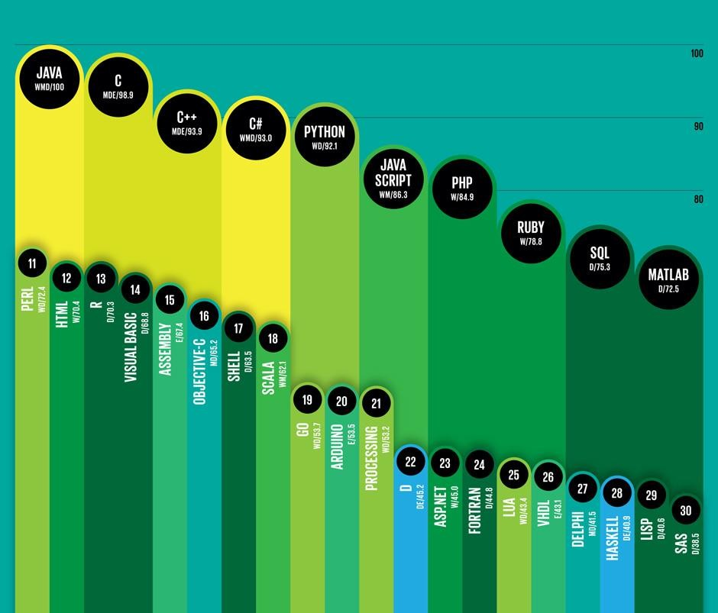
Popularity
Top 10 Programming Languages.
IEEE Spectrum’s 2014 Ranking.
Infographic:
Brandon Palacio
http://spectrum.ieee.org

Slide 13
Getting Started
There are three different ways to start Python
Interactive Interpreter
from Unix, Linux, DOS, etc.
Python shell begin with >>>
Script from the Command-line
Install python.
python [YourScriptFileName.py]
Integrated Development Environment (IDE)
You can run Python from a graphical user interface (GUI) environment.
All in One solution like IDLE in next slide.

Slide 14
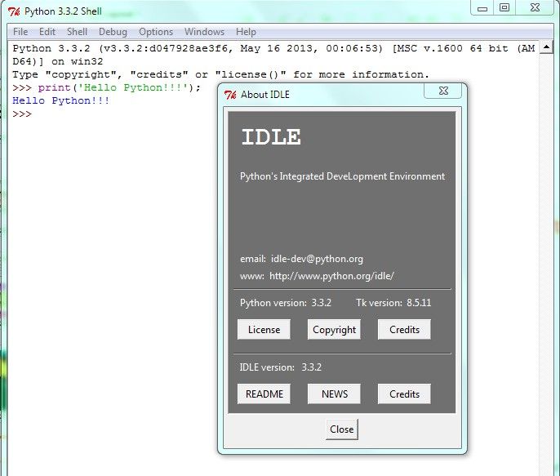
Getting Started
IDLE IDE
Download Python from
http://python.org
Install it.
Run it.

Slide 15
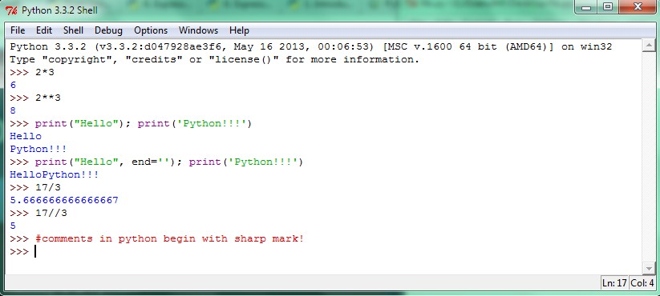
Python Shell

Slide 16
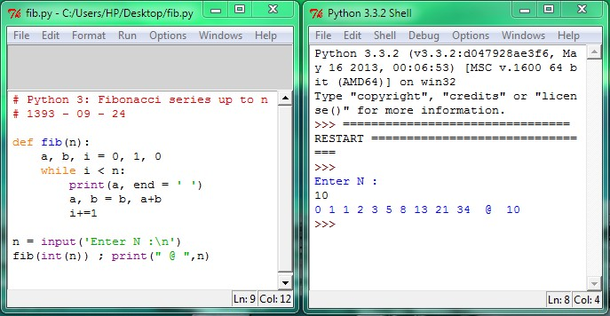
Simple Script with Output

Slide 17
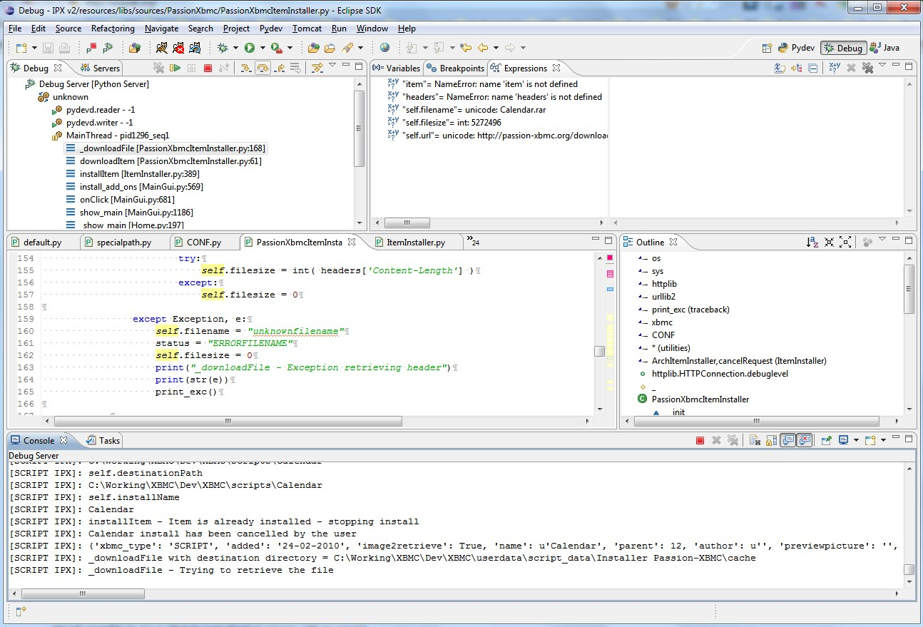

Other IDEs: PyDev
PyDev is a Python IDE for Eclipse
http://pydev.org/

Slide 18
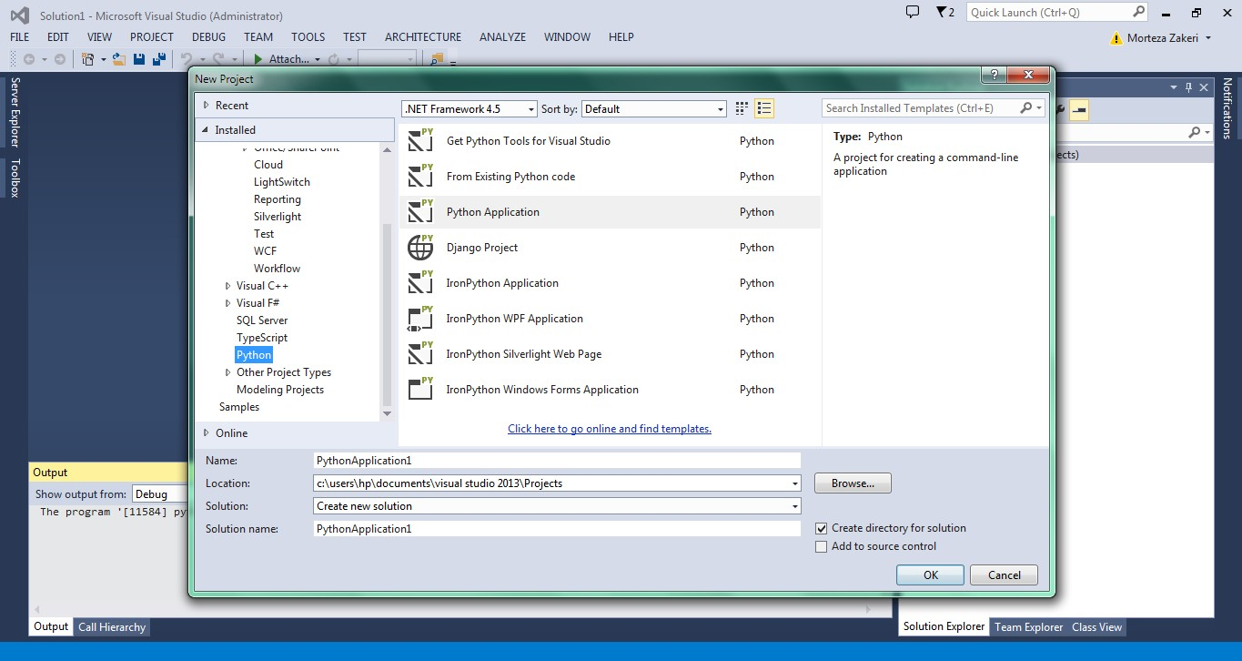
Other IDEs: Visual Studio

Slide 19
Python Basics: Objects and Variables
In python everything is an object.
So a variable is an object.
A variable is name given to a memory location to store value in the computer’s main storage.

Slide 20
Python Basics: Objects and Variables
Every object / Variable has three components:
Identity
Object’s address in memory does not change once it has been created.
Type (or Class)
A set of values and the allowable operations on those values exist for each type.
Type of type is type!!!
Value
To bind value to a variable using assignment operator ( = ), for example:
x = 12345

Slide 21
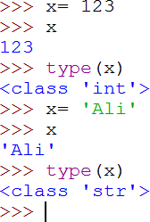
Python Basics: Objects and Variables
Python is a dynamically typed language, so:
Use Late Binding (run time binding).
No need to declare variable before binding a value.
Any given variable can have its value altered at any time!

Slide 22
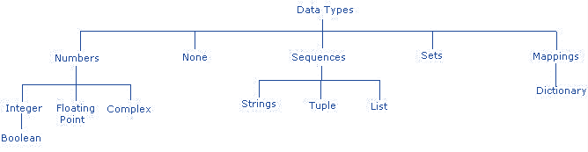
Primitive Data Types
Python has some standard types that are used to define the operations possible on them and the storage method for each of them.

Slide 23
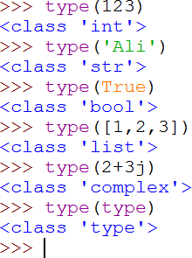
Primitive Data Types

Slide 24
Operators
Basic Operators
Arithmetic (+, - , *, /, %, //, **)
Assignment (=, +=, -=, *=, /=, %=, //= ,**= )
Comparison (<, >, <=, >=, ==, !=)
Logical (and, or, not)
Notes:
• + on strings does string concatenation
* on (string * int) repeats string

Slide 25
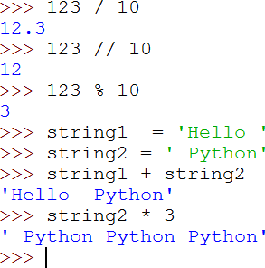
Operators

Slide 26
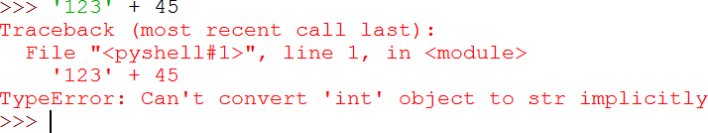
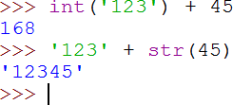
Type Conversion
Python has strong typing language (unlike JavaScript)
We need to use type converter functions:

Slide 27
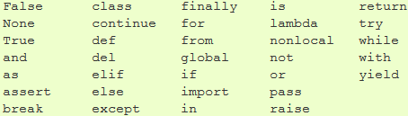
Syntax and Semantic: Simplicity
Python syntax is simple, simple, simple!!!
Full python grammar (BNF) is less than 120 line!
There are less than 35 keywords in python.

Slide 28
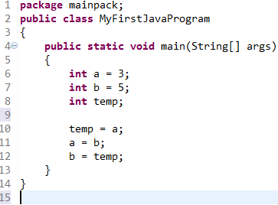
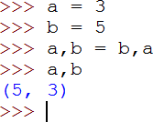
Syntax and Semantic: Powerfully
Simple Swap in Java:
Simple Swap in Python:

Slide 29


Input and Output
Script to calculate circle area:
Output:

Slide 30
Identifiers
A Python identifier is a name used to identify a variable, function, class, module, or other object.
An identifier starts with a letter A to Z or a to z or an underscore (_) followed by zero or more letters, underscores, and digits (0 to 9).
Python does not allow punctuation characters such as @,
$, and % within identifiers.
Python is a case sensitive programming language. Thus Var and var are two different identifiers in Python.

Slide 31

Lines
Single-Line Statements
Statements in Python typically end with a new line.
Multi-Line Statements
character ‘\’ use to denote that the line should continue.

Slide 32

Lines
Statements contained within the [ ], { }, or ( ) brackets do not need to use the line continuation character. For example:
line containing only whitespace, possibly with a comment, is known as a blank line, and Python totally ignores it.

Slide 33
Lines
Multiple Statements on a Single Line
The semicolon ( ; ) allows multiple statements on the single line.
Multiple Statement Groups called Suites
Groups of individual statements making up a single code block are called suites.
Compound or complex statements, such as “if”, “while”, “def”, and “class”, are those which require a header line and a suite.

Slide 34
Blocks and Indentations
Blocks begin with colon mark ( : )
Nested blocks are allowed.
Line Indentation use to determine blocks scope!
The number of spaces in the indentation is variable, but all statements within the block must be indented the same amount
pass keyword use to fill empty or not implementation blocks body.
pass ≡ do nothing

Slide 35
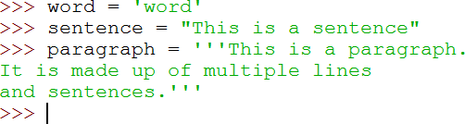
Quotations
Python accepts single ('), double (") and triple (''' or """) quotes to denote string literals, as long as the same type of quote starts and ends the string.
The triple quotes can be used to span the string across multiple lines.

Slide 36
Comments
A hash sign (#) that is not inside a string literal begins a comment.
All characters after the # and up to the physical line end are part of the comment, and the Python interpreter ignores them.

Slide 37
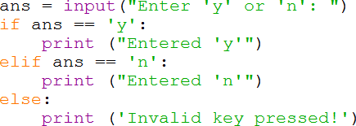
Control Flow: Conditions
Like other languages, Python has if and else statements
Python’s “else-if” is spelled elif

Slide 38

Control Flow: Conditions
Python has an easy to use if-syntax for setting the value of a variable!

Slide 39
Truth and Falsity Value Testing
Any object can be tested for truth value, for use in a condition.
False:
1. None (≡ 𝑛𝑢𝑙𝑙)
False (Python >= 2.2.1)
Zero of any numeric type, e.g., 0, 0.0, 0j
Any empty sequence or dictionary, e.g., ‘ ‘, ( ), [ ], { }
True:
Everything else

Slide 40


Control Flow: Loops
While loop
The while loop continues to execute the same body of code until
the conditional statement is no longer True.
We can use break and continue inside the loops

Slide 41

Control Flow: Loops
For loop
The for loop in Python is much simpler that other C-like
languages.
We can use range() function to produce a list of numbers.

Slide 42
Sequence Types
There are three basic sequence types:
lists
Tuples
range objects
Additional sequence types include:
Strings (str)
Binary Data (bytes, bytearray, memoryview)

Slide 43
Sequence Types
Sequence types are very like together.
All of them consist of iterables objects.
There are some difference:
Lists are mutable, heterogeneous.
Tuple are immutable, heterogeneous.
Ranges are immutable, homogeneous.
String are immutable, homogeneous.
Immutable ≡ 𝐶𝑎𝑛′𝑡 𝑢𝑠𝑒 𝑎𝑠 𝑙 − 𝑣𝑎𝑙𝑢𝑒

Slide 44
Lists
Lists are similar to arrays in C. One difference between them is that all the items belonging to a list can be of different data type.
[] – an empty list.
[6] – an one-element list.
[5, 1+2j, ’hello’] - a 3-element list (heterogeneous).
[[1,2], [3,4], [5,6]] - a list of lists.

Slide 45
Lists
Lists may be constructed in several ways:
Using a pair of square brackets to denote the empty list:
L = []
Using square brackets, separating items with commas:
L = [a] or L = [a, b, c]
Using a list comprehension:
L = [x for x in iterable]
Using the type constructor:
L = list() or L = list(iterable)

Slide 46
list comprehension
A compact way to process all or part of the elements in a sequence and return a list with the results.
result = ['{:#04x}'.format(x) for x in range(256) if x % 2 == 0]
generates a list of strings containing even hex numbers (0x..) in the range from 0 to 255.
The if clause is optional. If omitted, all elements in range(256) are
processed.

Slide 47
Tuples
A tuple is another sequence data type that is similar to the list.
A tuple consists of a number of values separated by commas.
The main differences between lists and tuples are:
Lists are enclosed in brackets ( [ ] ), and their elements and size can be changed, while tuples are enclosed in parentheses ( ( ) ) and cannot be updated.
Tuples can be thought of as read-only lists.

Slide 48
Tuples
Tuples may be constructed in a number of ways:
Using a pair of parentheses to denote the empty tuple:
T = ()
Using a trailing comma for a singleton tuple:
T= 1, or T = (1,)
Separating items with commas:
a, b, c or (a, b, c)
Using the tuple() built-in:
T = tuple() or T = tuple(iterable)

Slide 49
Ranges
The range type represents an immutable sequence of numbers and is commonly used for looping a specific number of times in for loops.
The advantage of the range type over a regular list or tuple is that a range object will always take the same (small) amount of memory, no matter the size of the range it represents (as it only stores the start, stop and step values, calculating individual items and subranges as needed).

Slide 50
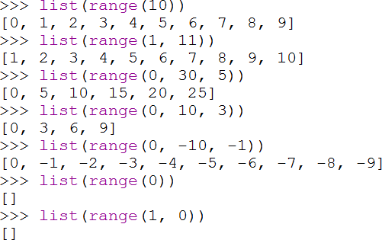
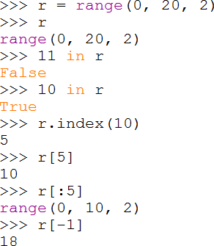
Ranges

Slide 51
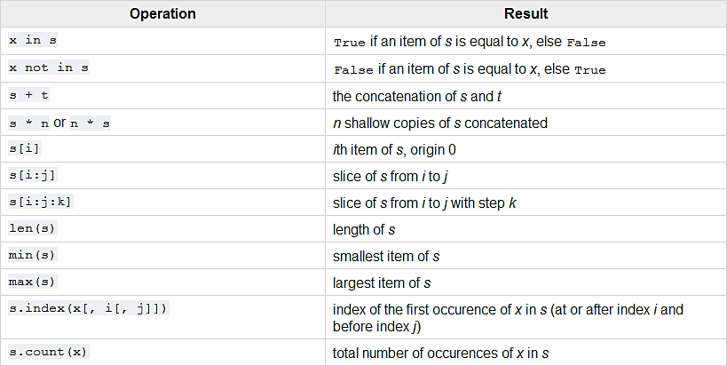
Common Sequence Operations

Slide 52
Dictionaries
Python's dictionaries are hash table type. They work like
associative arrays in Perl and consist of key-value pairs.
Keys can be almost any Python type, but are usually numbers or strings. Values, on the other hand, can be any arbitrary Python object.
Dictionaries are enclosed by curly braces ( { } ) and values can be assigned and accessed using square braces ( [] ).
Dictionaries have no concept of order among elements. It is incorrect to say that the elements are “out of order”; they are simply unordered.

Slide 53
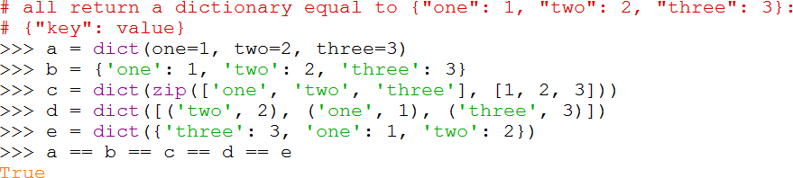
Dictionaries

Slide 54
Functions
Function objects are created by function definitions. The only operation on a function object is to call it:
function-name(argument-list).
There are really two flavors of function objects:
built-in functions
user-defined functions.
Both support the same operation (to call the function), but the implementation is different, hence the different object types.

Slide 55
Methods
Method is a function defined in a class namespace.
There are two flavors:
built-in methods (such as append() on lists)
class instance methods.
Built-in methods are described with the types that support them.

Slide 56
Define Functions
Function blocks begin with the keyword def followed by the
function name and parentheses.
The first statement of a function can be an optional statement
- the documentation string of the function or docstring.
The code block within every function starts with a colon ( : ) and is indented.
The statement return [expression] exits a function, optionally passing back an expression to the caller. A return statement with no arguments is the same as return None.

Slide 57

Define Functions

Slide 58
Arguments Passing
Pass by reference vs value
All parameters (arguments) in the Python language are passed
by reference.
If you change what a parameter refers to within a function, the change also reflects back in the calling function.
If you assigned new value to parameter by assign operation (=),
new reference will be created (call by value!!!)
So python provide two semantic by one syntax in function calling!!!

Slide 59
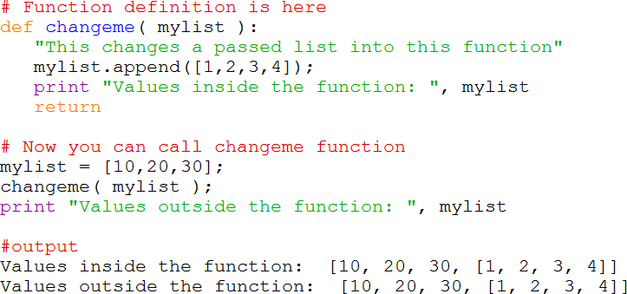
Arguments Passing

Slide 60
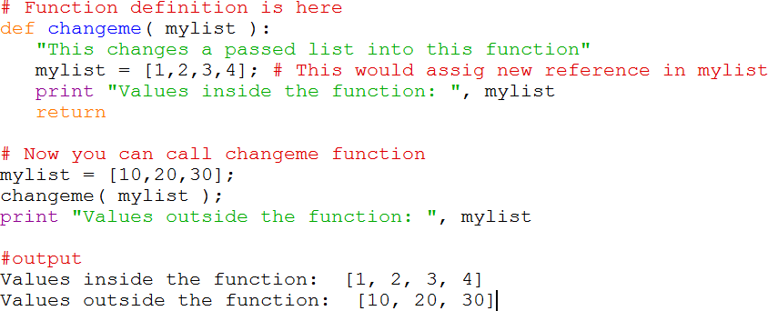
Arguments Passing

Slide 61
Arguments Types
You can call a function by using the following types of formal arguments:
Required arguments
Keyword arguments
Default arguments
Variable-length arguments

Slide 62
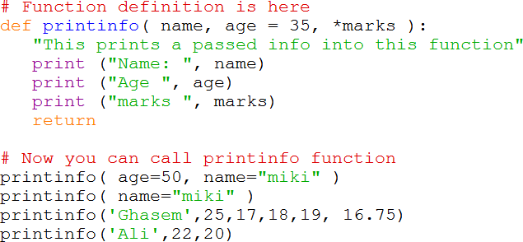
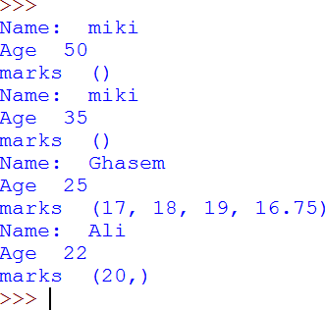
Arguments Types

Slide 63
Nested Functions
Function scopes (and class scopes) can be nested.
Python using static scope.
Inner function can’t access to variables reference exist in outer function but R-Value allowed!
nonlocal keyword use to access outer variables so dynamic scope will provide!!!

Slide 64
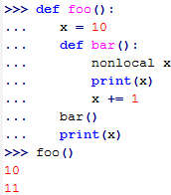
Nested Functions

Slide 65

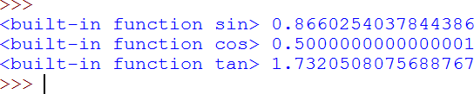
First-Class Objects
Almost everything (including functions, classes, etc) in Python is a ﬁrst-class object!

Slide 66
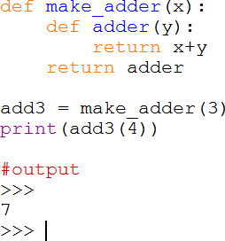
First-Class Objects

Slide 67

Object-Oriented Python
Python support object-oriented (class and objects)
Python support multiple inheritance

Slide 68
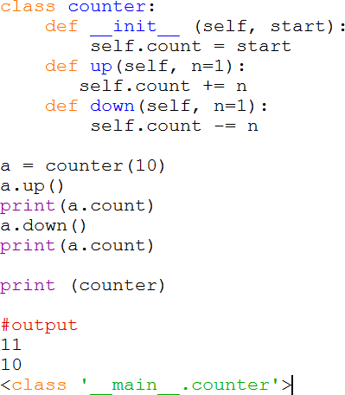
Object-Oriented Python

Slide 69
Destroying Objects (Garbage Collection)
Allocating and freeing memory is not your problem!
Python uses reference counting.
An object's reference count increases when it's assigned a new name or placed in a container (list, tuple, etc). The object's reference count decreases when it's deleted with del.
When an object's reference count reaches zero, Python collects it automatically.

Slide 70
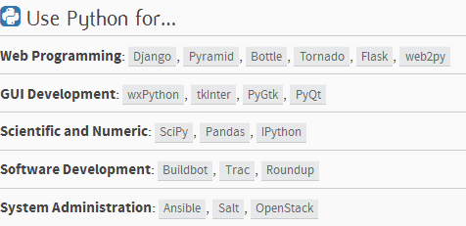
Be Pythonic!

Slide 71
Alternative Python Implementations
CPython: Traditional implementation of Python that we used in this introduction.
IronPython: Python running on .NET
Jython: Python running on the Java Virtual Machine (JVM)
PyPy: A fast python implementation with a just in-time (JIT) compiler.
More:
https://www.python.org/download/alternatives

Slide 72
Famous Apps. written in python
Dropbox: A web-based file hosting service
BitTorrent: original client, along with several derivatives.
Ubuntu Software Center: A graphical package manager, installed by default in Ubuntu 9.10 and higher.
More:
http://en.wikipedia.org/wiki/List_of_Python_software

Slide 73
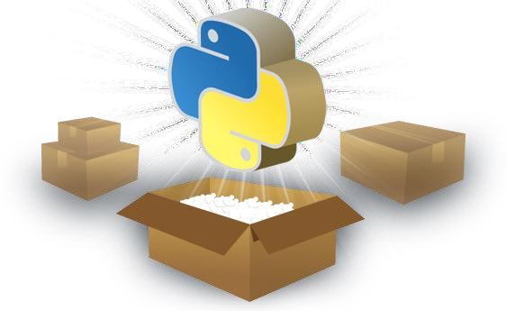
Summary
Python is
High-Level
Multi-Paradigm
and has
Dynamic Type
Strong Type
and use
Call by Reference(and value)
Static (and Dynamic) Scope

Slide 74

Reference
Python Official Website
http://python.org/
Python 3 Documentation
http://docs.python.org/3/
Python Tutorials
http://www.tutorialspoint.com/python/
Learning Python, Fifth Edition
Mark Lutz, Published by O’Reilly Media, Inc. 2013

